Slide 1


Join at slido.com #3436682
ⓘ Start presenting to display the joining instructions on this slide.

Slide 2

Clearing the Air: Unveiling Insights on Health Through Data Analysis

Slide 3
THE Process
Data and Process

Slide 4
OpenWeatherMap Air Pollution API
Global Health Data Exchange
Australian Bureau of Statistics (2021) Regional Population
API NINJAS
Kaggle: cause of death
Kaggle air pollution
Study Objective:
Analyse key air pollution metrics at varying scales and over different timeframes to evaluate impact on public health and wellbeing.
Collation
Cleaning
2
Data Preparation
Descriptive Stats
1
Define
3
Exploratory Data Analysis
Graphical Stats
Input: Hypothesis
6
Review &
Feedback
4
Interpretation & Validation
5
Conclusions
Output: Reporting

Slide 5

LET’S HAVE SOME FUN
HYPOTHESES Q&A

Slide 6

The greater the population size, the higher the recorded pollution in a town or city.
ⓘ Start presenting to display the poll results on this slide.
Notes:
Alvin

Slide 7

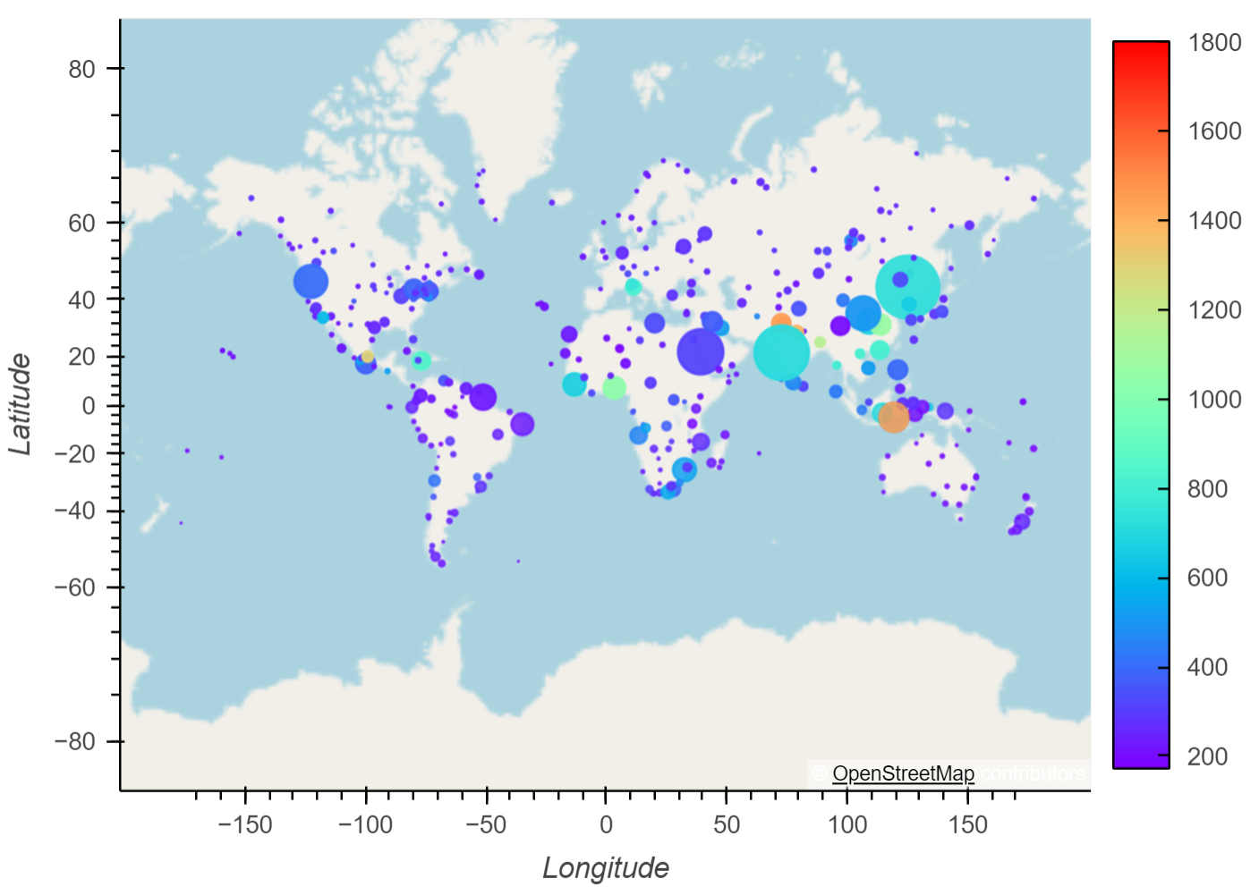
Global Winter CO Pollution Levels in μg/m by Population
Q&A - Population versus Pollution - Global

Slide 8
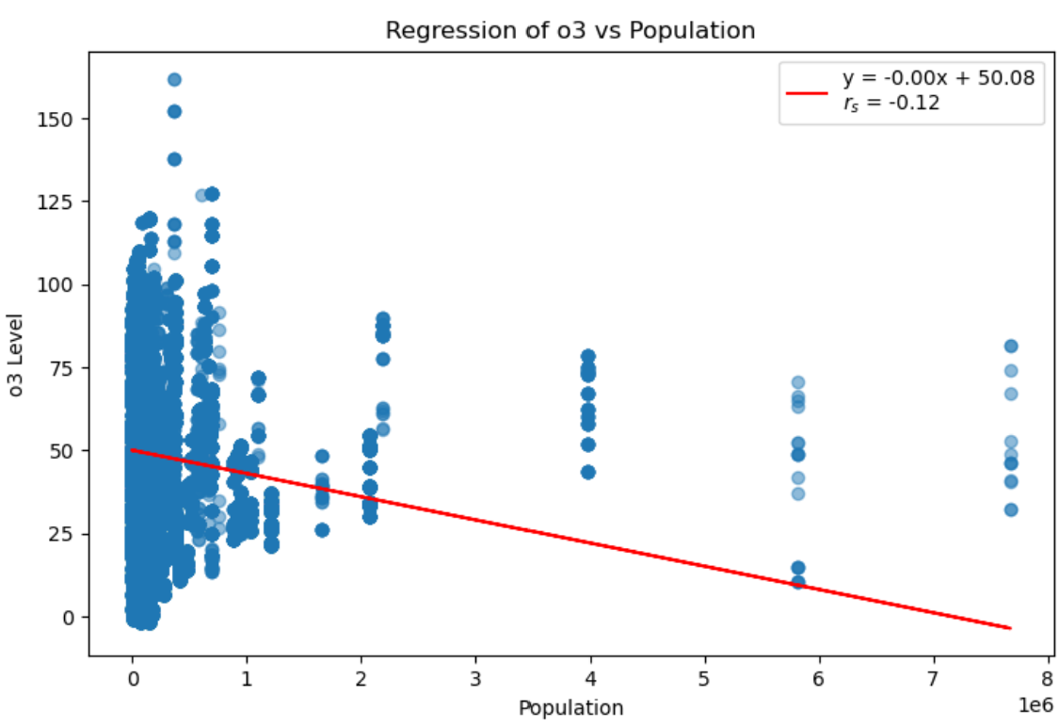
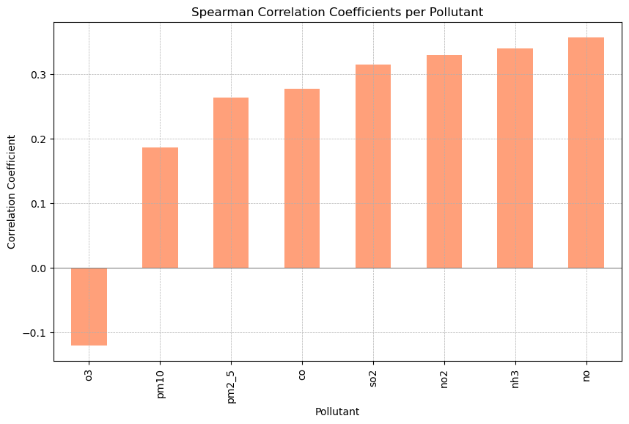
Ozone
Q&A - Population versus Pollution - Global

Slide 9
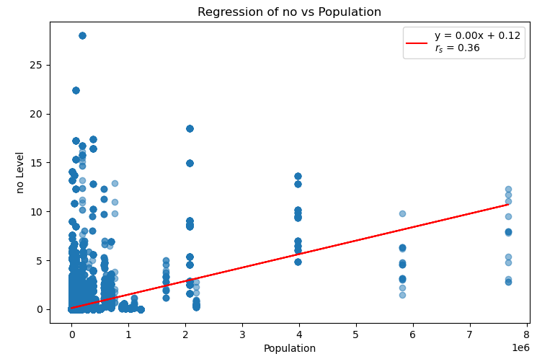
Nitrous Oxide
Q&A - Population versus Pollution - Global

Slide 10
Higher population densities are associated with higher air pollution levels in Australian towns and cities.
ⓘ Start presenting to display the poll results on this slide.

Slide 11

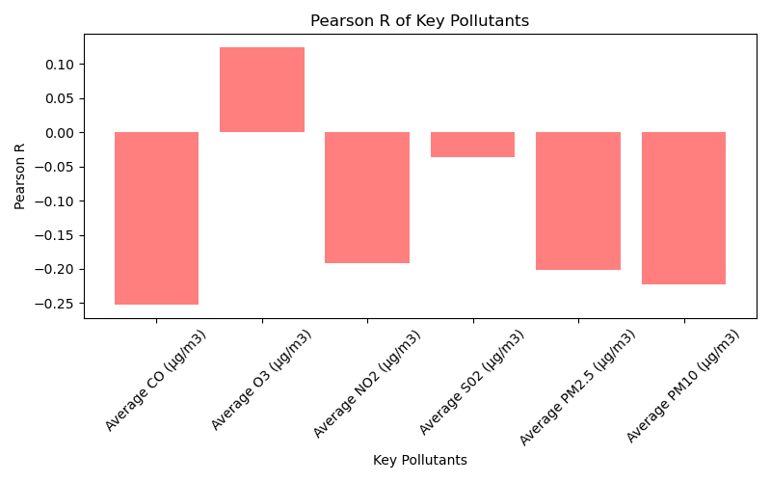
Q&A - Population versus Pollution – Local (Australia)
Notes:
Lower population density: fewer sources of pollution per square km
Stringent environmental regulations: help to reduce emissions of air pollutants and improve air quality.
Geographic factors: Vast open spaces, prevailing winds, rainforest etc.
Low levels of industrial activity: fewer industrial sources of pollution

Slide 12
Globally pollutant levels vary significantly across the four season.
ⓘ Start presenting to display the poll results on this slide.

Slide 13
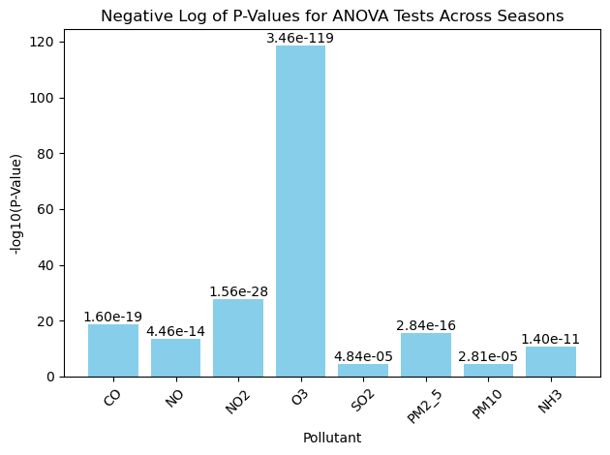
Q&A - Pollutant Levels By Season
Notes:
Population and Pollution: Higher population densities tend to increase levels of nitrogen oxides and particulate matter.
Ozone Behavior: Ozone levels often decrease when other pollutants increase, indicating complex chemical interactions.
Seasonal Impact: The relationship between population and pollutants varies slightly with the seasons, showing how weather and activities influence air quality.

Slide 14

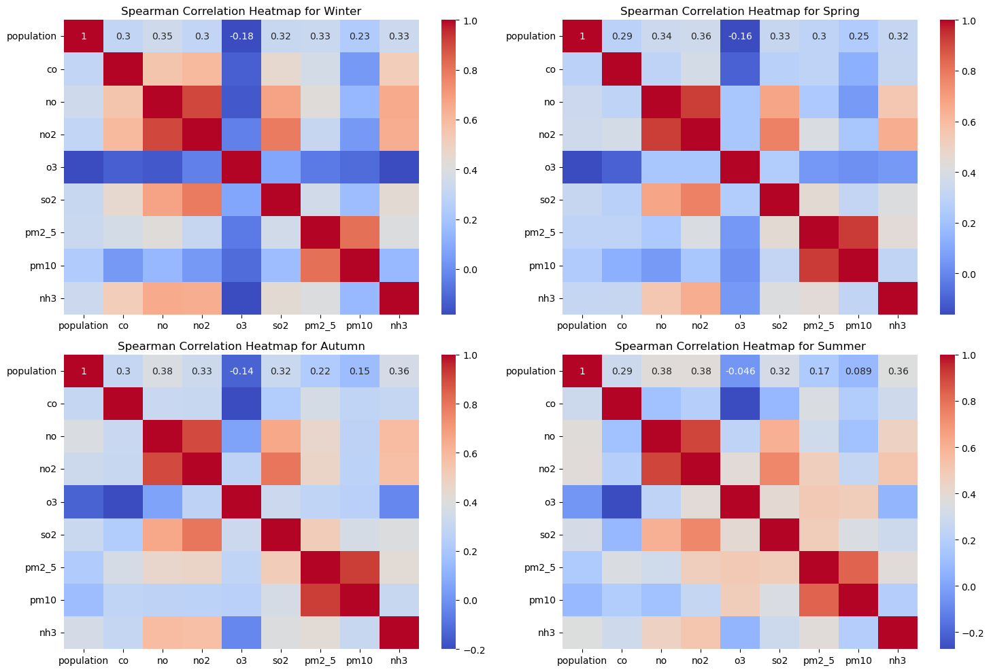
Autumn
Winter
Summer
Spring
Q&A - Pollutant Levels By Season
Notes:
Population and Pollution: Higher population densities tend to increase levels of nitrogen oxides and particulate matter.
Ozone Behavior: Ozone levels often decrease when other pollutants increase, indicating complex chemical interactions.
Seasonal Impact: The relationship between population and pollutants varies slightly with the seasons, showing how weather and activities influence air quality.

Slide 15
Higher levels of air pollutants correlate with higher occurrences of depressive disorders.
ⓘ Start presenting to display the poll results on this slide.

Slide 16
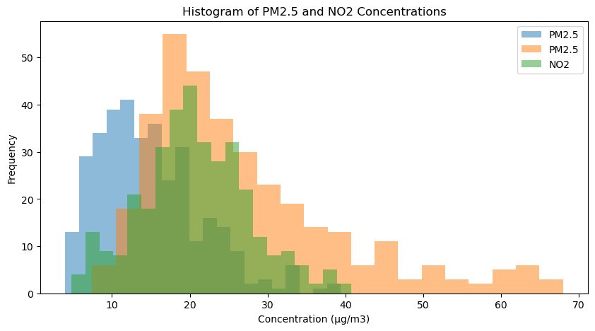
Q&A – Pollution Versus Depression

Slide 17

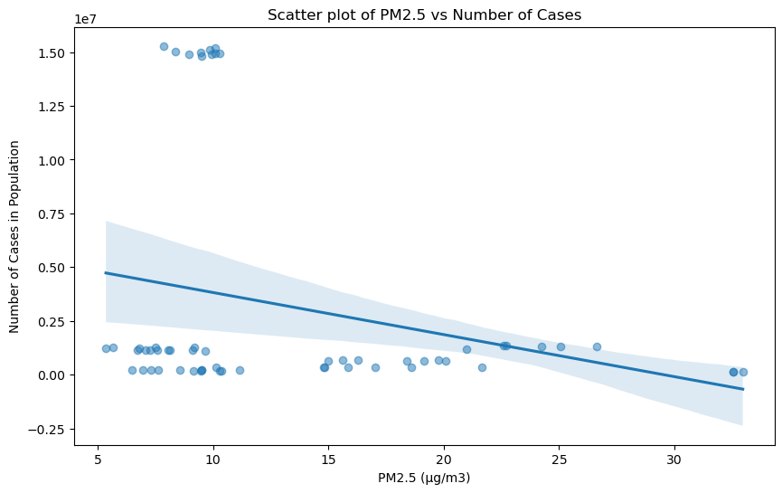
Correlation Coefficient: -0.26
Q&A – Pollution Versus Depression

Slide 18
Which air pollutant has the most significant correlation to respiratory deaths?
ⓘ Start presenting to display the poll results on this slide.

Slide 19

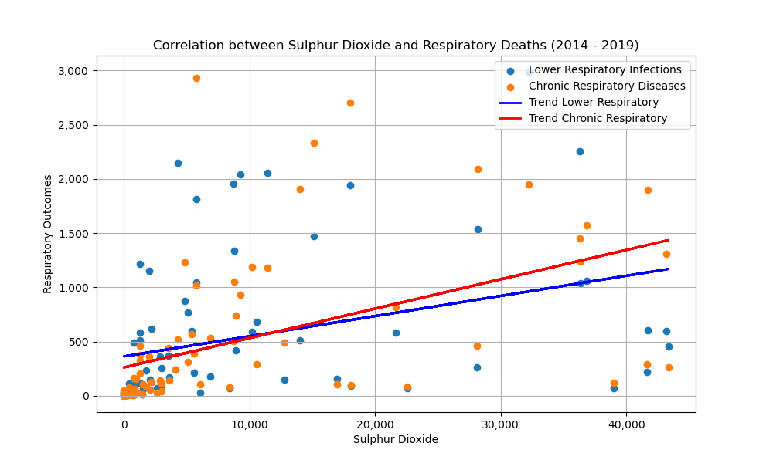
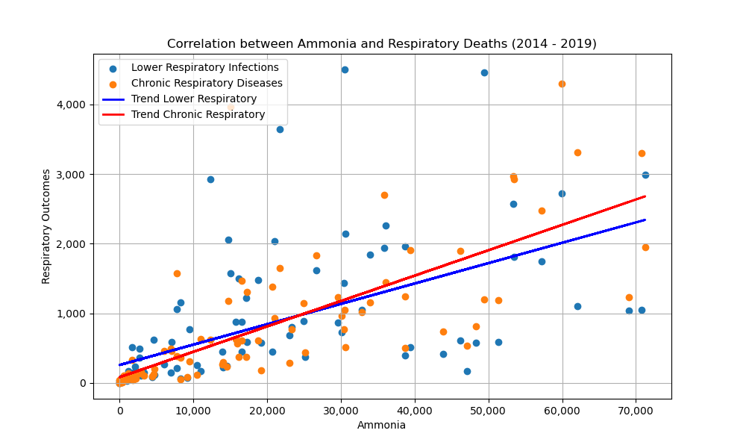
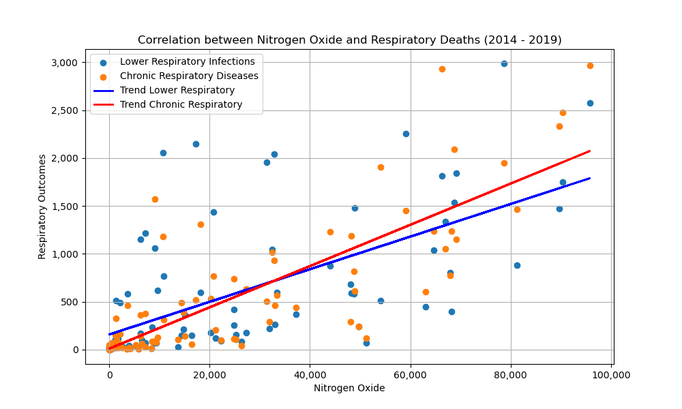
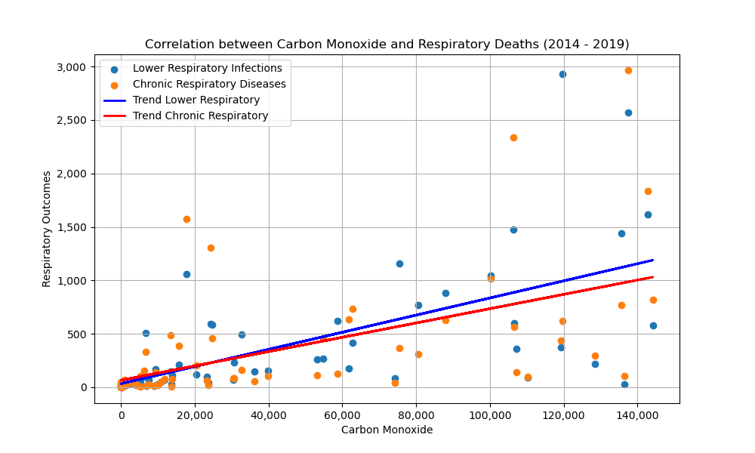
Q&A – Pollution Versus Depression

Slide 20
CONCLUSIONS
So, What are Our Thoughts?

Slide 21
Q&A – Pollution Versus Depression

Slide 22

QUESTIONS?

